Slide 1
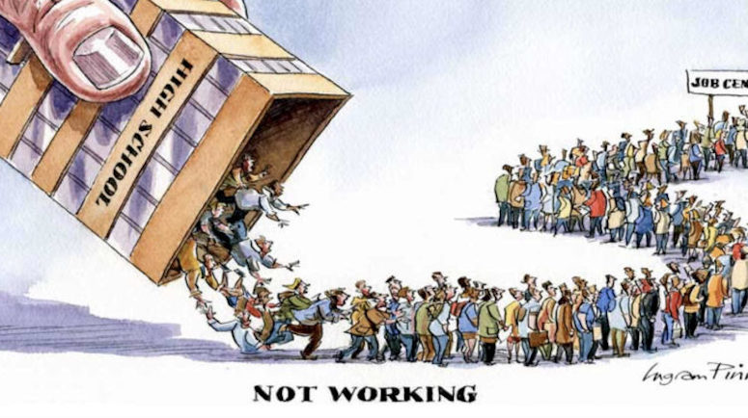
Un - Employment in INDIA from 2016-2021
Created by – Rounak Pyne

Slide 2
Context and overview :
Definition of un-employment.
Overall India's unemployment in the last 5 years.
Urban vs rural unemployment in the last 5 years.
State wise highest and lowest unemployment data.
Impact of lockdown in un-employment in 2020-2021.
Participation rate in urban vs rural in AVG.
Conclusion and findings.

Slide 3
Definition of un-employment
The term unemployment refers to a situation where a person actively searches for employment but is unable to find work. Unemployment is considered to be a key measure of the health of the economy.
The most frequently used measure of unemployment is the unemployment rate. It's calculated by dividing the number of unemployed people by the number of people in the labor force.

Slide 4
Overall India's unemployment in the last 5 years.

Slide 5
Urban vs rural unemployment in the last 5 years.

Slide 6
State wise highest and lowest unemployment data.

Slide 7
Impact of lockdown in un-employment in 2020-2021.

Slide 8
Participation rate in urban vs rural in AVG.

Slide 9
Conclusion and findings.
Overall India's unemployment in the last 5 years.
In the years 2017-2019 we saw a gradual spike in the number but as we moved towards 2020 we saw a more than usual spike in the number of unemployment.
Urban vs rural unemployment in the last 5 years.
In the years 2017-2019 we saw more un-employment in the urban region vs the rural region which is usual but we saw in the pandemic year of 2020 we that rural region is having a spike in un-employment because most people moved from urban to rural areas due to lack of work as there were covid restrictions.
State wise highest and lowest unemployment data.
As we can see that Tripura , Jammu and Kashmir and Haryana have more than 50% un-employment rate with Tripura being the highest at more than 80% unemployment in the last 5 years.
Impact of lockdown in un-employment in 2020-2021.
Post lockdown we saw a major change in the un-employment market where we saw a major shift where Haryana, Rajasthan and Goa has saw a increase in the numbers in 2021 whereas states like Tripura, Sikkim and Assam have seem a major drop in terms of unemployment.
Participation rate in urban vs rural in AVG.
It’s interesting to see that people from the rural areas have participated more in the survey than the people in the urban areas.

